Slide 1
Exercises- Propositional Logic
Gog Alexandra

Slide 2
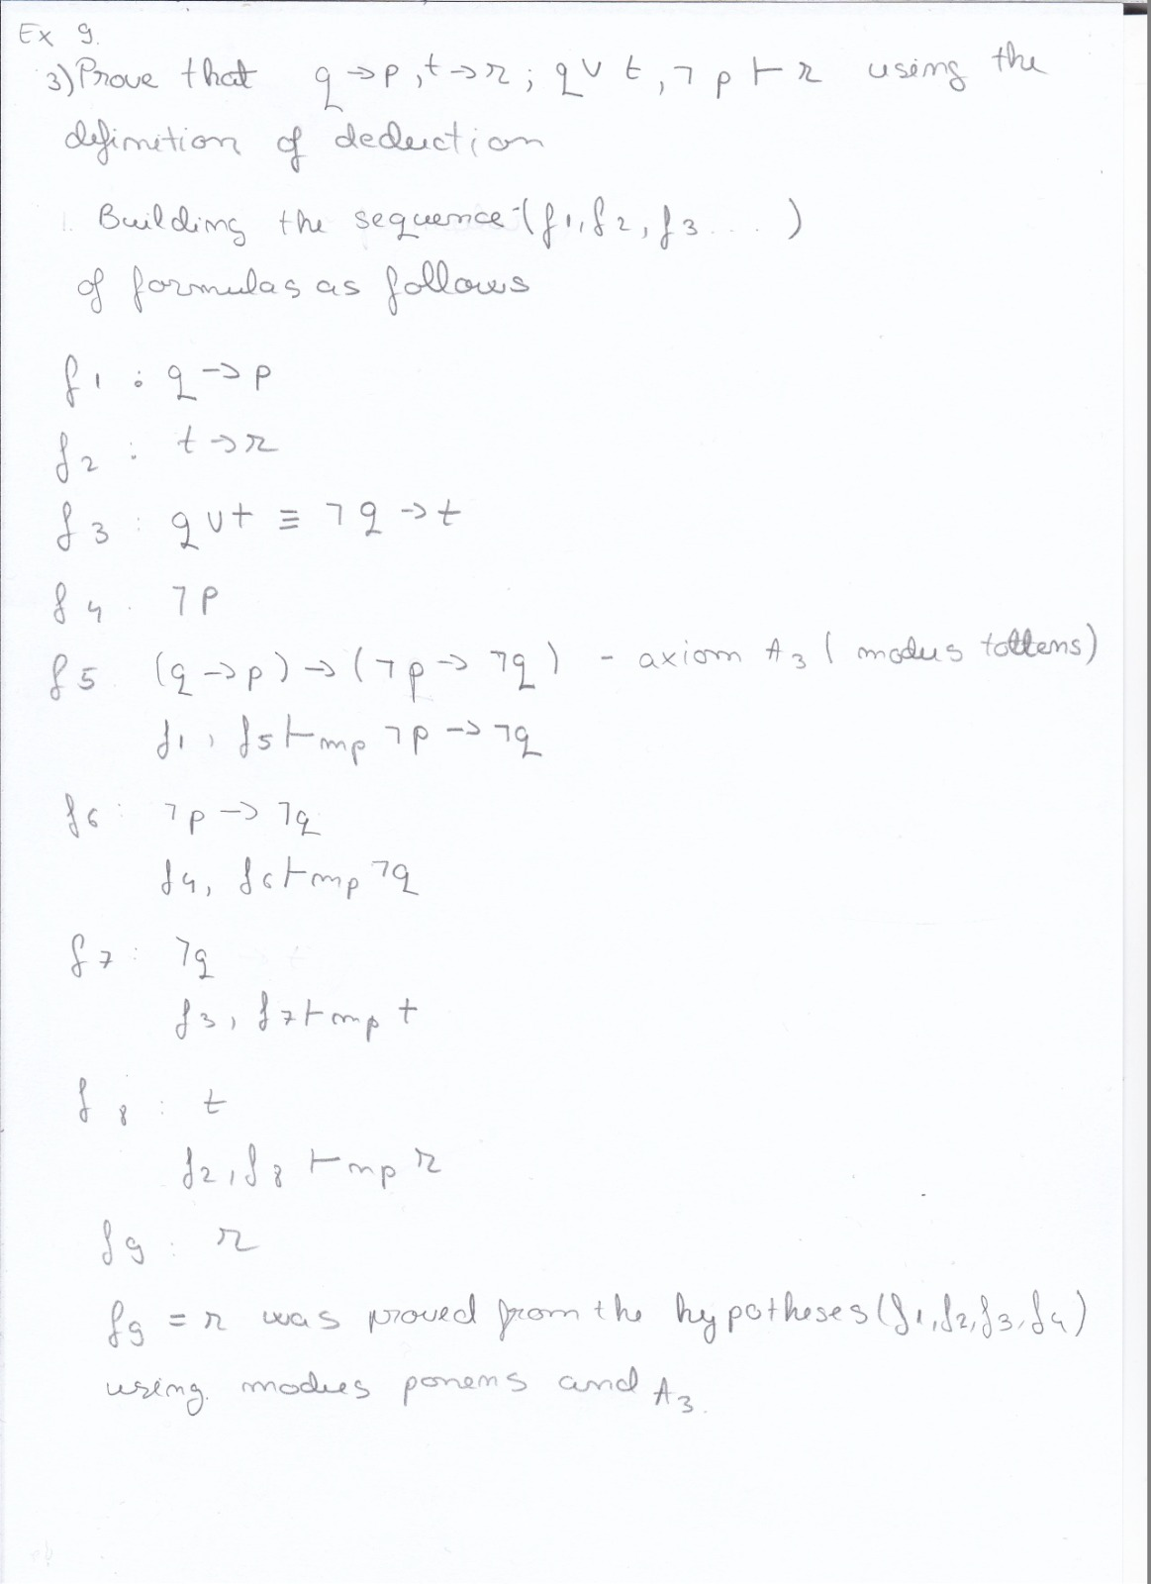
Exercise 9 Using the definition of deduction, prove the following deductions:

Slide 3
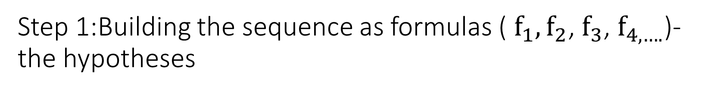
Step 1:Building the sequence as formulas ( $f_{1},f_{2}$, $f_{3}$, $f_{4,….}$)- the hypotheses
The first hypothesis
The second hypothesis
The third hypothesis (we transformed it using the logical equivalences )
The forth hypothesis

Slide 4
Step 2: Building the next formulas using axioms A3 and modus pones

